Slide 1


Anxiety and Depression Detection Using Natural Language Processing and Sentiment Analysis
Submitted by: Narala Venkata Koushik Reddy (22BDS0431),
Mopuru Sai Abhinav Reddy (22BCT0134),
Kenguva Abhinav (22BKT0062).
Submitted to: Prof. Rajarajan G, School of Computer Science and Engineering (SCOPE)

Slide 2

Problem Statement
Detecting Anxiety and Depression
Mental health conditions are increasingly expressed online, but identifying them from large, unstructured text volumes is difficult without automation.
Need for Scalable Solutions
A scalable, intelligent system is needed to analyze text data and detect early signs of mental health issues for timely intervention, research, and awareness.

Slide 3
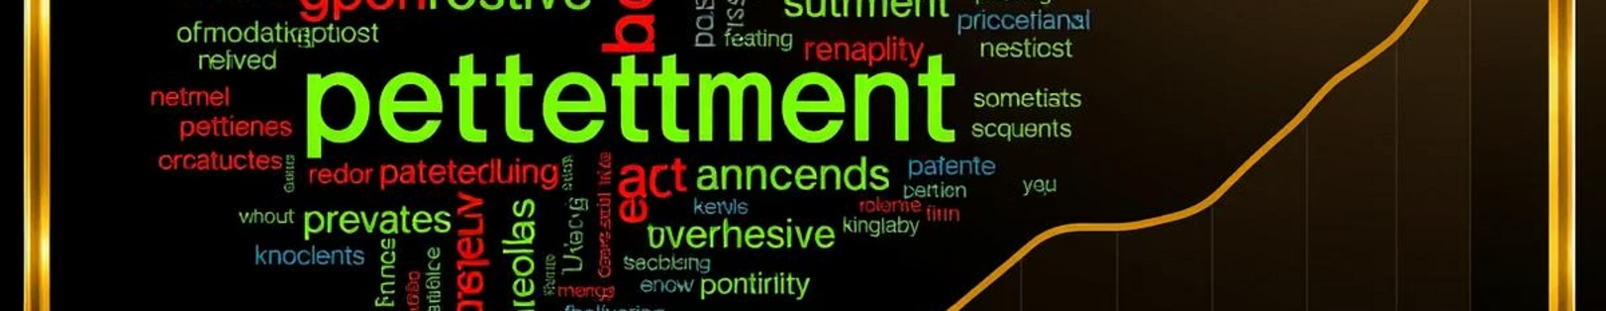



Objective
Intelligent System
Early Screening
Support & Awareness
Build a system leveraging NLP and sentiment analysis to detect anxiety and depression from user-generated text.
Enable early screening and risk identification through automated analysis of emotional content.
Integrate into digital mental health platforms or research tools for timely intervention and awareness.

Slide 4
Progress So Far & Next Steps
Progress Made
Next Steps
Defined emotional keywords for classification.
Begin manual labeling of emotional categories for each post.
Selected subreddits for data collection.
Train classification models using labeled data for automated detection.
Built Python script using Reddit API (PRAW) with keyword filtering.
Collected and stored 8,432 relevant posts in JSON format.
Extracted metadata (id, title, selftext) and converted to DataFrame.
Ensured duplicate filtering and estimated ~20-30 min run time.

